Slide 1
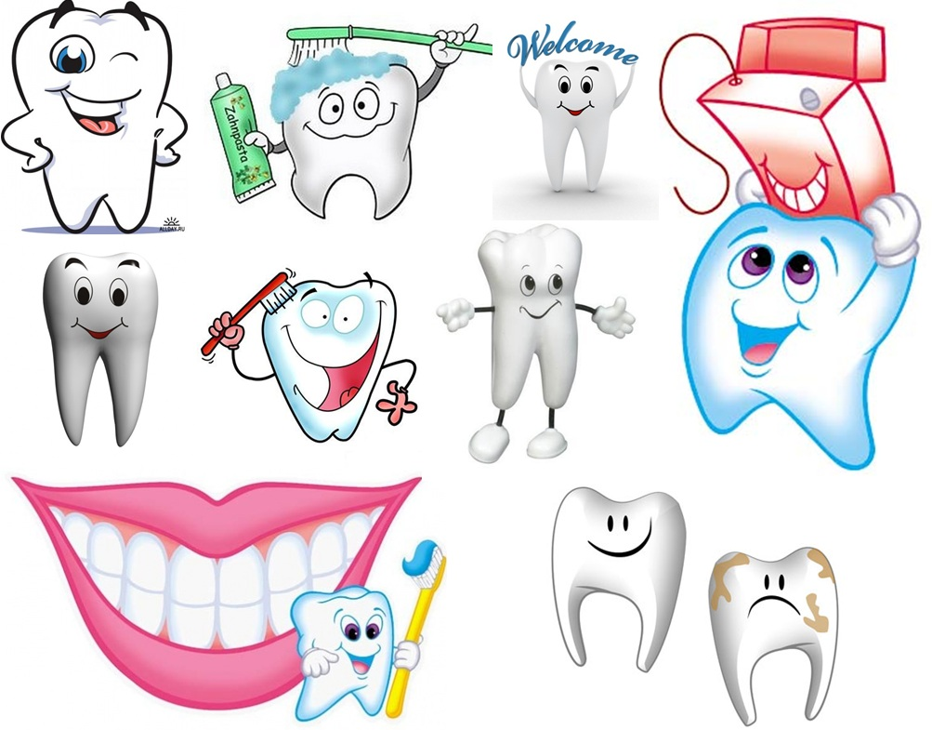
Teeth.
How to look after your teeth?

Slide 2
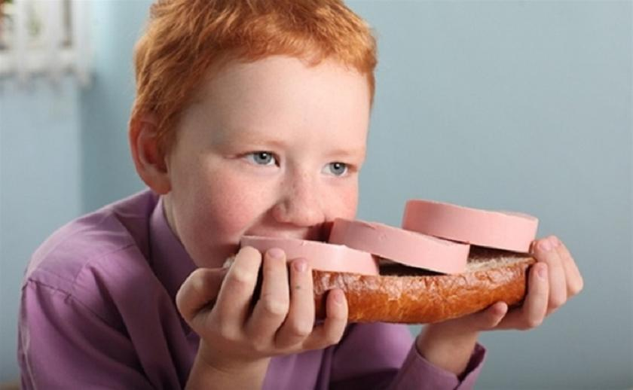
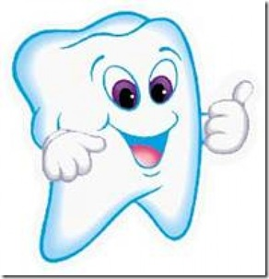
Why do we need our teeth?
Eating!
Teeth bite and chew food so that it is small enough to be swallowed.
Teeth help you to form words so that you can speak properly.

Slide 3

Why do we need our teeth?
Good Speech.
Your tongue and lips touching the teeth help you make many sounds.

Slide 4


Why do we need our teeth?
Good Breath.
If you leave food around your teeth, your breath will smell bad.

Slide 5


Why do we need our teeth?
Good Looks.
Healthy teeth that look good help you feel good. They give shape to your mouth and light up your smile

Slide 6


Why do we need our teeth?
Good Health.
Infection from a bad tooth can spread to other parts of your body.

Slide 7
When a doctor doctors a doctor,
does the doctor doing the doctoring
doctor as the doctor being doctored wants to be doctored or
does the doctor doing the doctoring doctor as he wants to doctor?

Slide 8
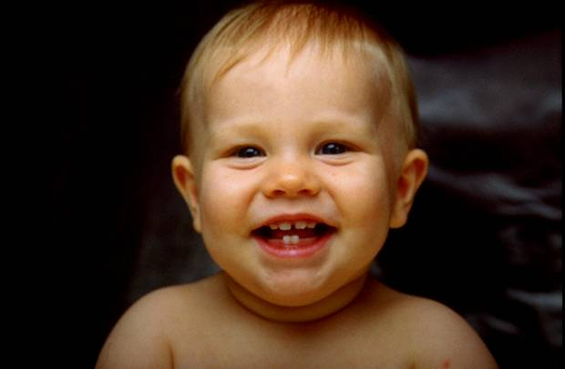

Teeth categories
Primary- baby teeth that grow first
Permanent- lifetime teeth

Slide 9
Primary- baby teeth
Your first teeth are called deciduous teeth (say dee-sid-you-us). (They can also be called milk teeth, baby teeth or primary teeth.)
They are called deciduous because like the leaves of a deciduous tree you lose them after a while.
You have 20 deciduous teeth and they start growing into your mouth from about 6 months of age.
All 20 teeth have grown into your mouth by about two and a half years of age.
From about 6 years of age until 12 years of age you start to lose them

Slide 10
Permanent- lifetime teeth
Your second teeth are called permanent teeth (say perm-an-ent) (also called adult teeth).
You will have 32 permanent teeth.
They are called permanent teeth because if you look after them you can have them for all of your life.
They begin growing through your gums from about 6 years and all 32 have finished growing into your mouth by about 18 – 25 years.

Slide 11
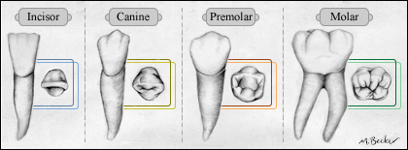
Why do teeth have different shapes?
Different teeth do different jobs.
Incisors are for cutting.
Canines are for tearing.
Molars and pre-molars grind up food until it's small enough to swallow.
Each type of tooth has a special shape so that it can do its job.

Slide 12
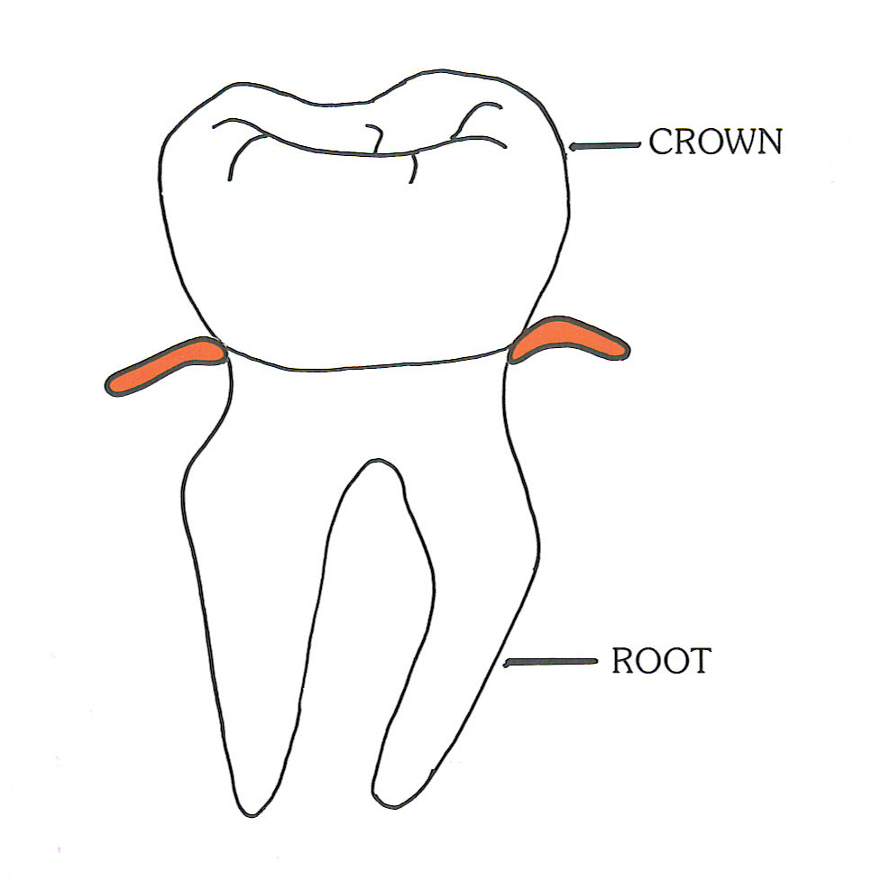
What does a tooth look like?
The crown is…
the part of the tooth above the gums. Just like a king’s hat!
The root is…
the part of the tooth
below the gumline.Just as the roots of a tree hold the tree in the ground, the roots of your teeth hold your teeth in your mouth.

Slide 13
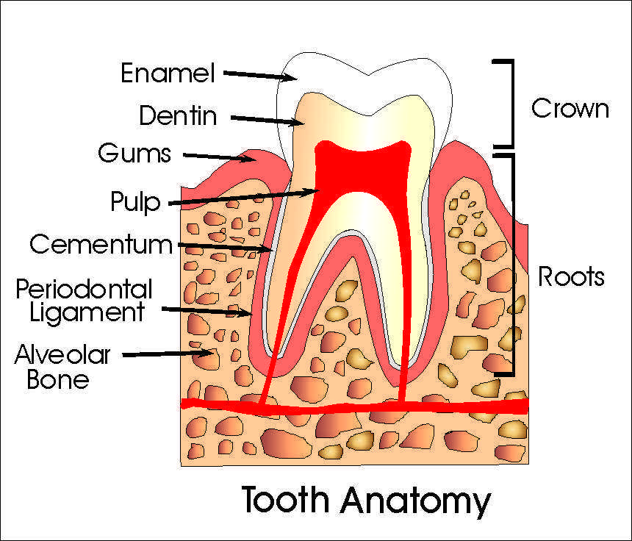
The aswers ex.2.b. p.116
1 crown
2 root
3 gum
4 jaw bone
5 enamel
6 dentil
7 pulp
8 cementum.
their score | All words (8) were written correctly | 1-2 words were written incorrectly | 3-4 words were written incorrectly | 5 words and <
their mark | 5 | 4 | 3 | 2

Slide 14
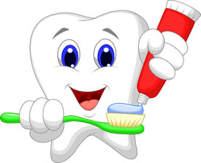

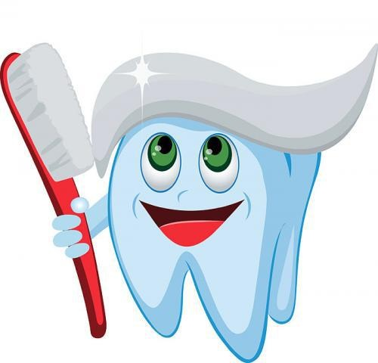
When should you clean your teeth?
When you wake up
After eating
At bedtime

Slide 15
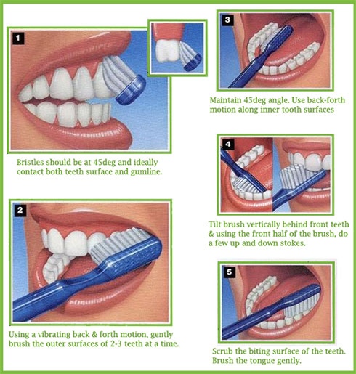
How to clean teeth correctly.

Slide 16
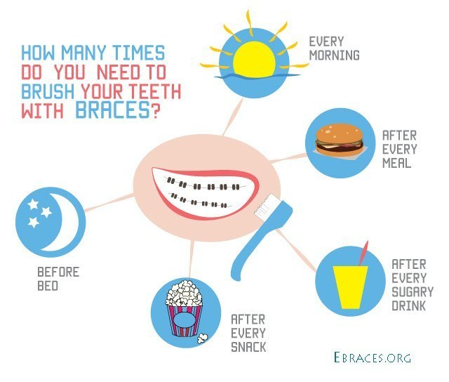
Some basic braces care tips
Chew your food thoroughly and eat slowly.
Rinse well with water after eating.
​Always brush after eating.
​Use a dental pick to get the large stuff.
​Brush all your teeth every
time.
Rinse well again.
Don’t play with your braces!

Slide 17
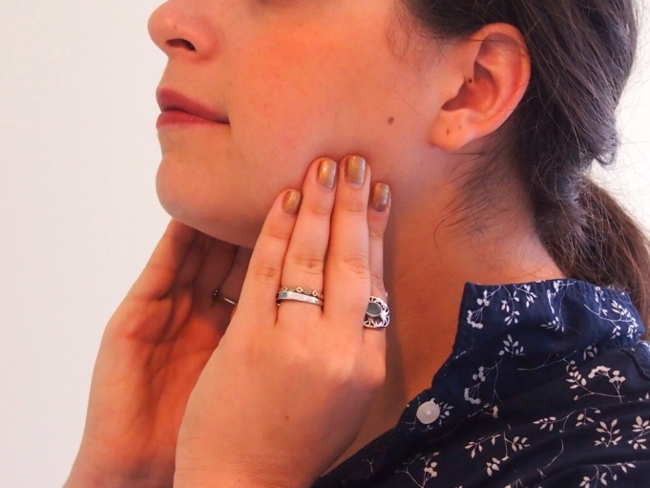

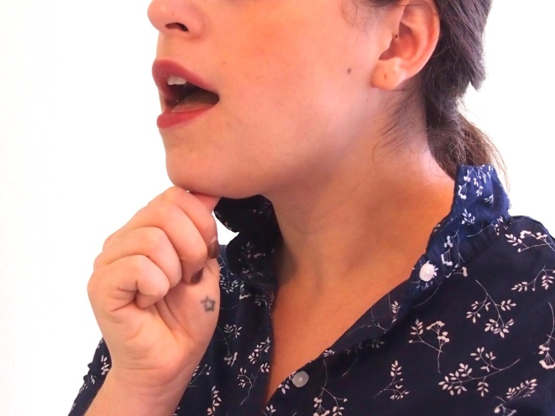
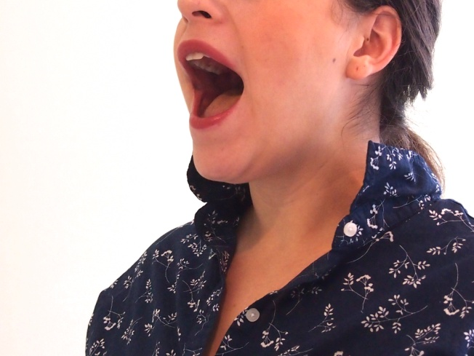
Exercises for teeth (№1-№4)

Slide 18
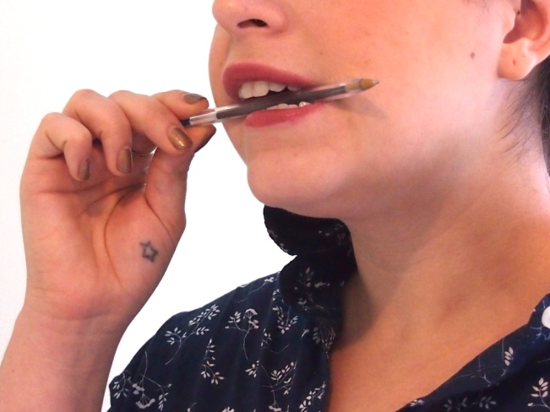
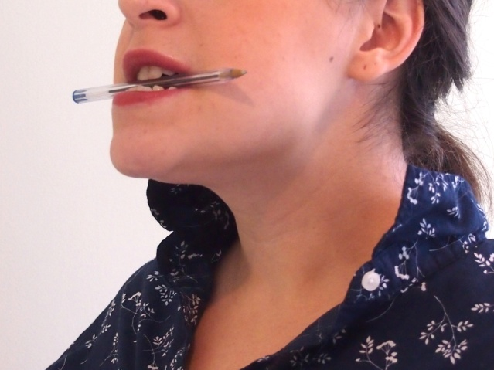
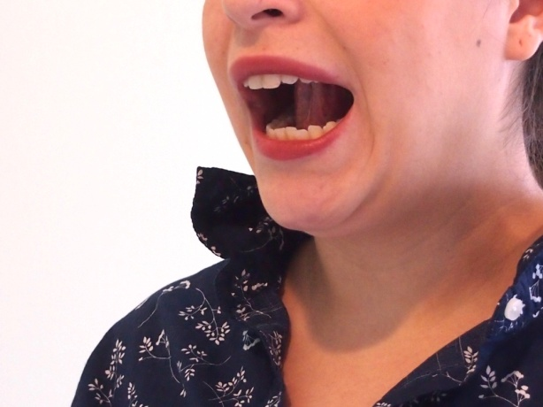
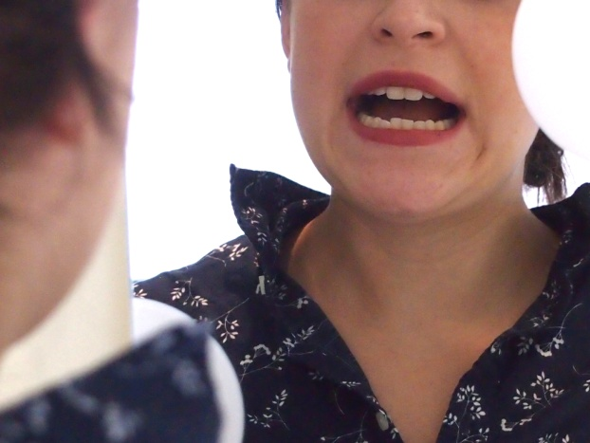
Exercises for teeth (№5-№6)

Slide 19
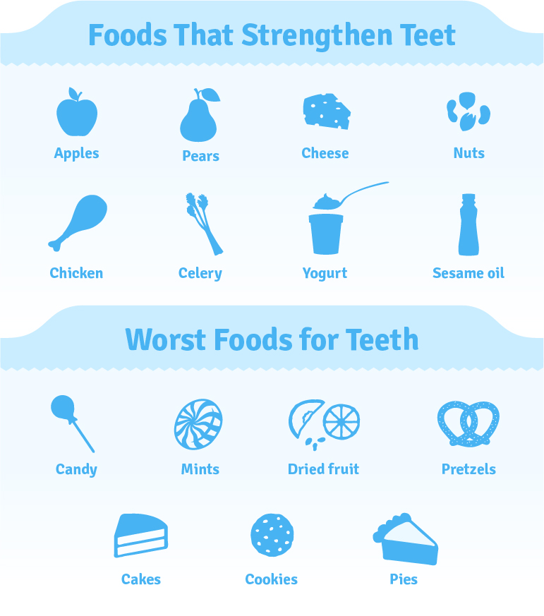
Good and bad food for teeth

Slide 20
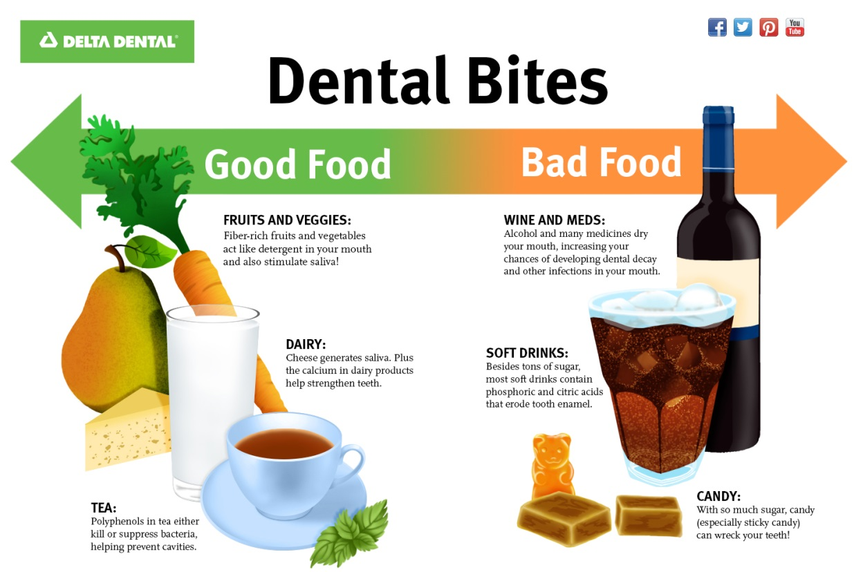

Slide 21
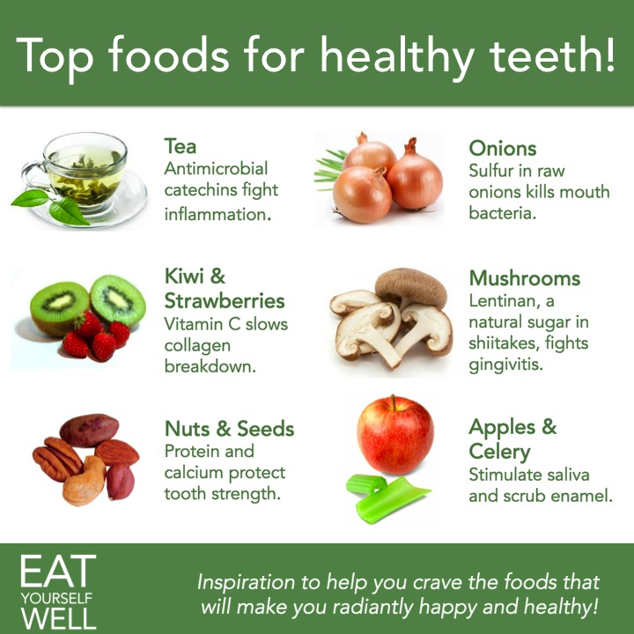

Slide 22
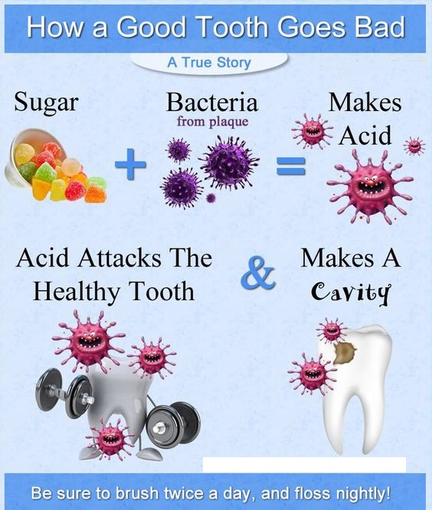

Slide 23
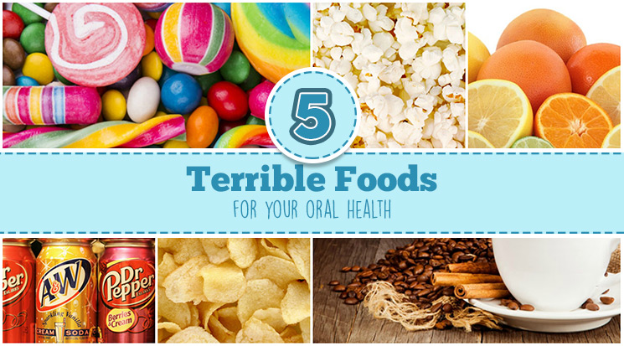
Can you cut out all sugar from your diet?
No, but you can cut down on it!
If you eat sweets:
Eat them at meal times.
Brush your teeth afterward.
If you cannot brush, swish with water and swallow!
This helps to remove food particles from your teeth.

Slide 24
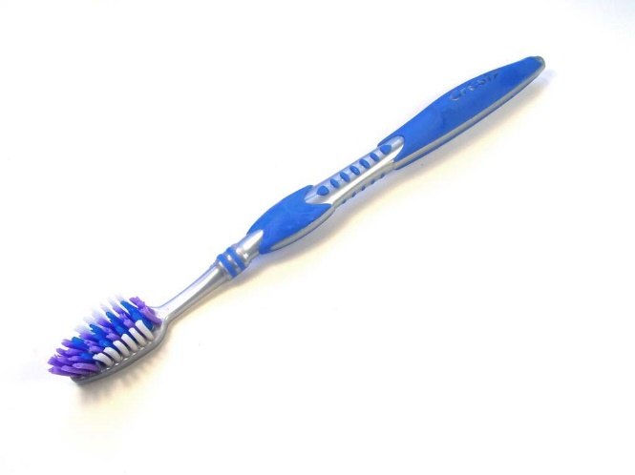
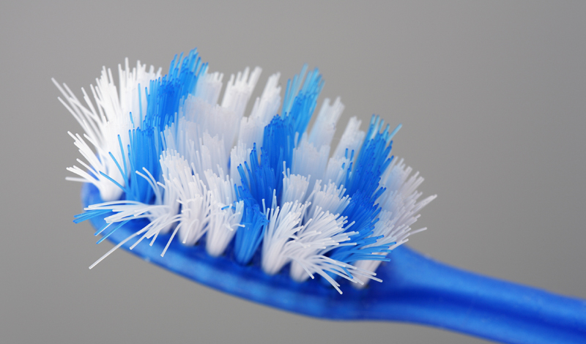
Get a new toothbrush…
Every 3 months.
When yours becomes frayed.
After you have been sick.
DON’T SHARE YOUR TOOTHBRUSH WITH ANYONE ELSE!

Slide 25
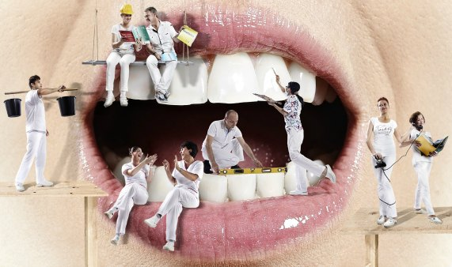
Be sure to visit your dentist twice a year.
If you have a cavity, the dentist will be able to find it when it is small.
The dental staff will apply fluoride to your teeth.
Dental sealants may be placed on your permanent back teeth to help prevent tooth decay.

Slide 26
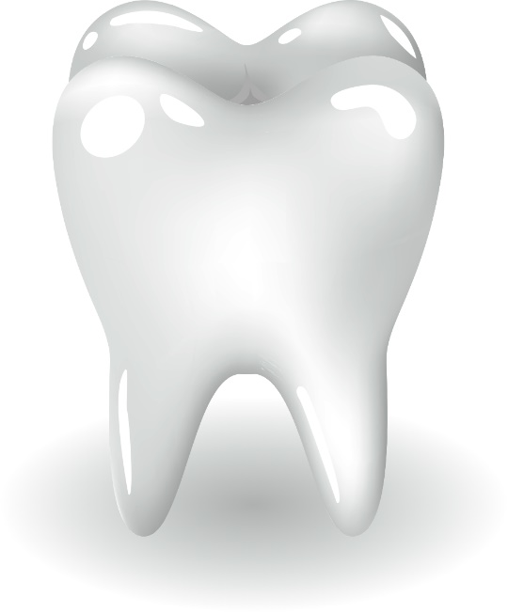
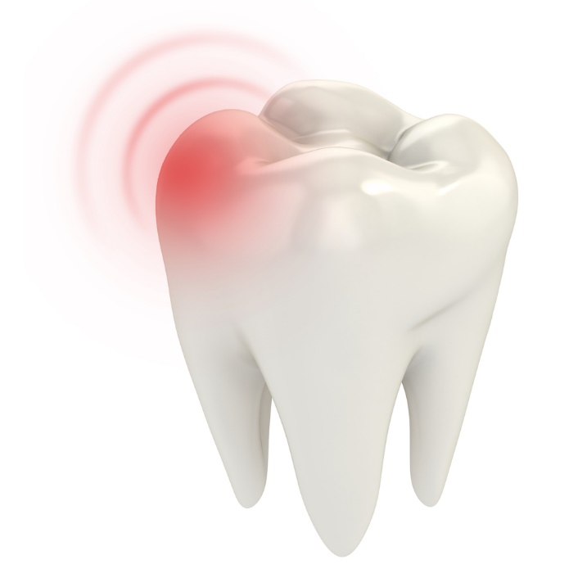
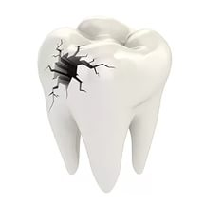
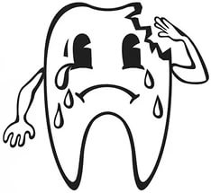
What are your results?

Slide 27
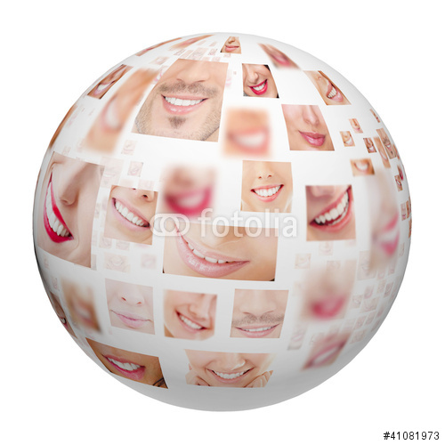


Slide 28
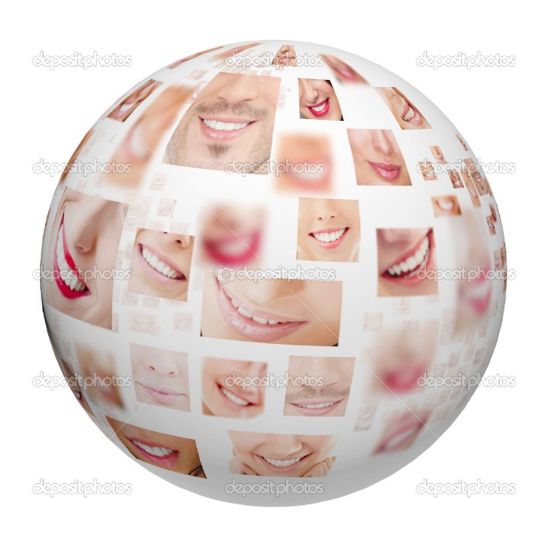
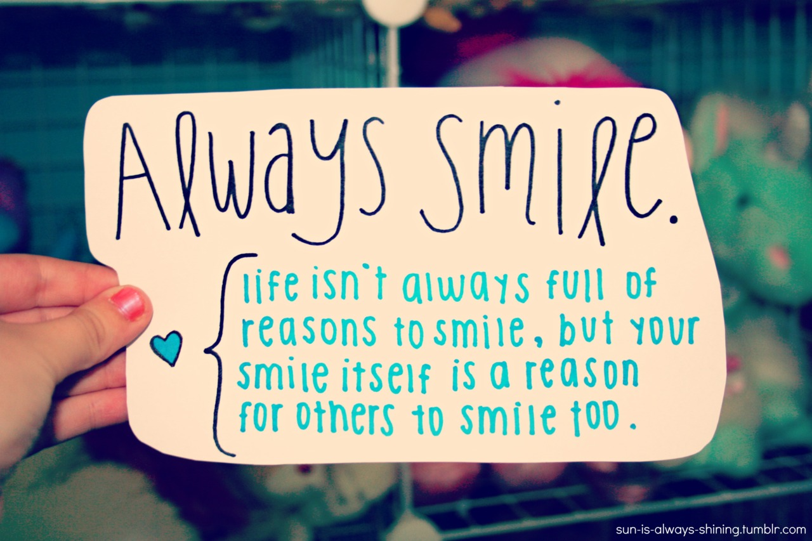

Slide 29



Slide 30

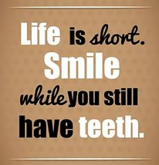

Slide 31



